Slide 1

AI - Powered Student Grading and Teacher Rating Automation System

Slide 2

AI-Powered Student Grading and Teacher Rating Automation System
Research Group: SST - Software Systems & Technologies
Project ID: 25-26J-162
Team Members
M Wanniarachchi W.A.P – IT22103154
Pathiraja P.U.M – IT22243362
Hettiarachchi R.H – IT22120052
Jayasooriya L.T – IT22095480
Supervisors
Professor Samantha Rajapaksha (Supervisor)
Senior Lecturer Bhagyanie Chathurika (Co-Supervisor)

Slide 3

Problem Statement
Current Challenges in Educational Assessment:
  Manual evaluation: time-consuming, subjective, inconsistent
  Teacher performance assessment: biased, limited metrics
  Scalability issues in large institutions
  Delayed feedback delivery
  Lack of personalized improvement guidance

Slide 4
Why This Research Matters ?
Growing need for Online/Remote Education Solutions
Demand for Objective, Consistent Evaluation Methods
Educational Institutions seeking efficiency and fairness
Technology Gap in Traditional Assessment Methods
Opportunity for AI/ML application in Education Sector

Slide 5
Main Research Objective
Primary Goal:
To design and develop a fully self-trained AI-powered system that automates student grading and Teacher Performance Evaluation using custom-built OCR, NLP, and ML models.

Slide 6

PROPOSED SOLUTION
Cross-Platform AI System:
  Web application for administration
  Mobile application for document capture
  Custom-built OCR, NLP, and ML components
  Integrated student grading and teacher rating
  Offline processing capabilities

Slide 7

System Workflow
End-to-End Process:
  Document Capture via Mobile/Web
  OCR Text Extraction and Preprocessing
  AI-Powered Analysis and Evaluation
  Score Generation and Feedback Creation
  Performance Analytics and Reporting

Slide 8
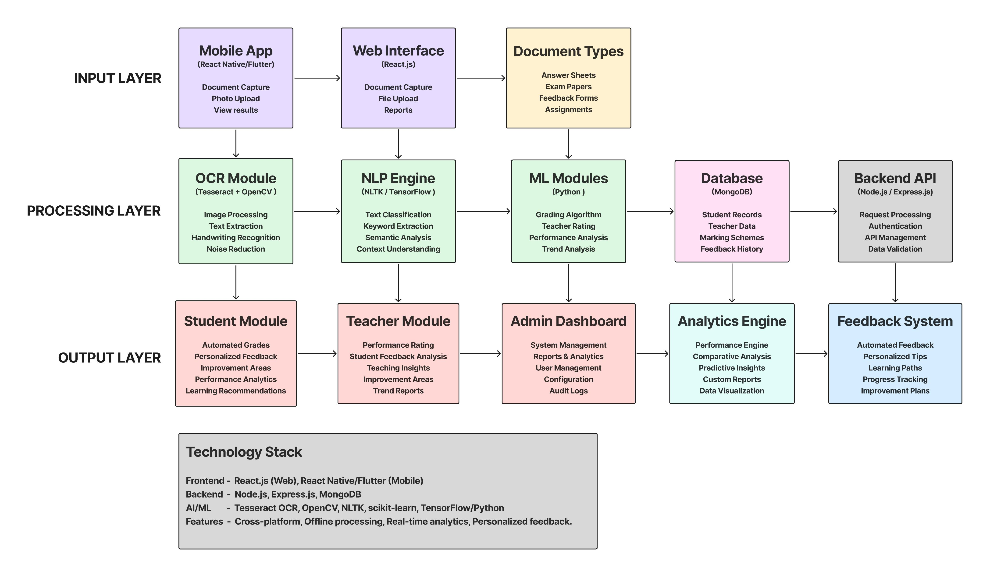
System Architecture
High-Level Architecture
Input Layer: Mobile capture, document upload
Processing Layer: OCR, NLP, ML engines
Analysis Layer: Student grading, teacher rating
Output Layer: Feedback, analytics, reports.
Data Layer: Secure storage and management

Slide 9

System Architecture Cont.

Slide 10
Specific Objectives & Team Allocation
  PATHIRAJA P.U.M (IT22243362):
  OCR Module & Student Grading Engine
  W.A.P.M Wanniarachchi (IT22103154):
  Mobile App & Teacher Rating System
  JAYASOORIYA L.T (IT22095480):
  Student Performance Analysis & Improvement
  Hettiarachchi R.H (IT22120052):
  Teacher Improvement Analysis & Feedback

Slide 11

OCR Module & Student Grading Engine
Pathiraja P.U.M – IT22243362

Slide 12
Overview of Contribution
Sub Objective
Develop custom OCR pipeline using open-source libraries
Key Tasks
Implement image preprocessing and OCR to extract handwritten/printed text
Novelty
Fully offline OCR and student grading engine(MCQ and Essay) custom-built for academic answer sheet and question wise explanation
Train NLP model to score answers using marking schemes

Slide 13
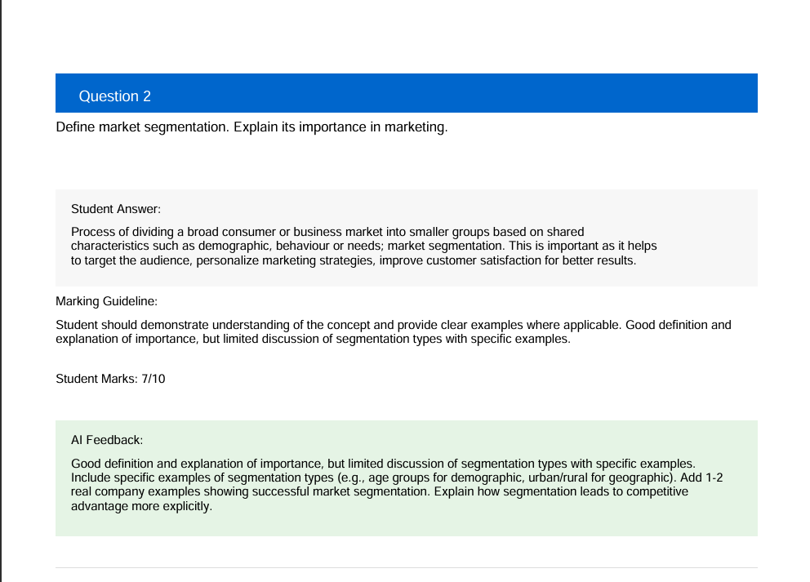
Example For Question Wise Explanation

Slide 14
Problem Context
Manual Grading is Time-Consuming and Inconsistent
Lack of Digital Tools for Handwritten Answer Evaluation
Limited Access to Online Grading Tools in Low-Connectivity Areas

Slide 15
Process Flow
Student Scans Answer Paper & Upload Via Mobile App
Server Stores Uploaded Paper
ML grading and explanation model analysis answered paper
Grading and question wise explanation generated
Mobile App & Web application Displays Analytics To Students/Teachers

Slide 16
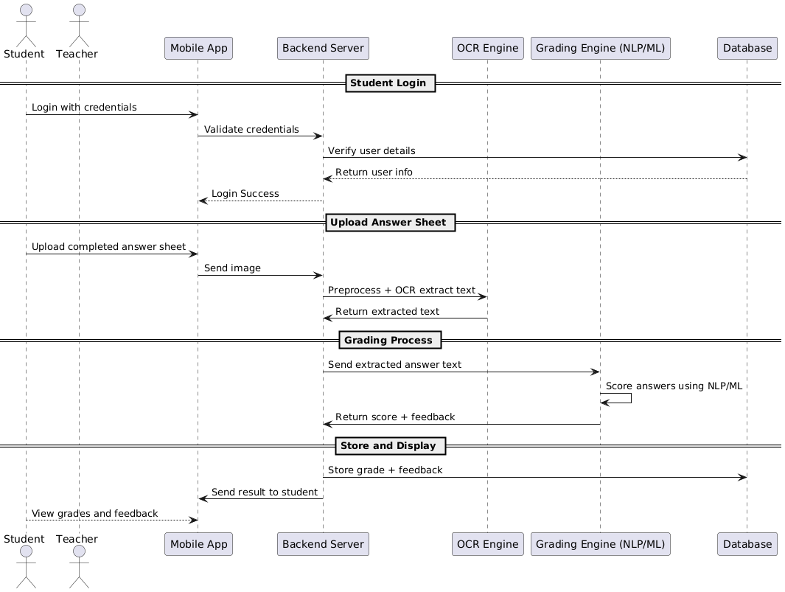
Process Flow Cont.

Slide 17
What is my Research ??
My research is about how to give a grading to the students of grade 11 English literature in Sri Lanka based on the papers they perform and how to give a question-wise explanation based on the grade 11 English literature syllables.

Slide 18
Gap Analysis: My Research vs. EnglishBuddy (Gurusinghe et al - ISSN 2659-2193 )
Feature / Aspect | My Research | EnglishBuddy by Gurusinghe et al.
OCR for Handwriting | Yes (custom OCR for handwritten answers) | No (typed input assumed)
Subject Focus | O/L literature | Only O/L English
Question Types | MCQ and Essay | Only Essay-type (dialogue, summary, etc.)
Grading Model | AI-based grading engine using NLP | Rule-based evaluation with NLTK/Ginger API
Question-wise Explanation | Yes | No (limited feedback, not question-specific)
Answer Formats Supported | Printed or handwritten answers via OCR | Structured typed answers only
User Roles and Accessibility | Teachers, students, mobile app users | Students, teachers (via web portal only)

Slide 19

What is My Contribution
Algorithm 1: Custom OCR Pipeline for Academic Papers
Problem:
Traditional OCR fails on handwritten academic answer sheets with poor image quality, skewed text, and mixed handwritten/printed content.

Slide 20

Solution Algorithm:
INPUT: Scanned answer sheet image
STEP 1: Image Preprocessing
- Convert to grayscale
- Apply Gaussian blur (remove noise)
- Adaptive thresholding (handle varying lighting)
- Morphological operations (clean text boundaries)
- Perspective correction (fix skewed images)
STEP 2: Text Region Detection
- Use MSER (Maximally Stable Extremal Regions)
- Apply connected component analysis
- Filter regions by size and aspect ratio
STEP 3: Character Recognition
- CNN-LSTM hybrid model
- Attention mechanism for focus
- Character-level prediction with context
STEP 4: Post-processing
- Spell correction using dictionary
- Grammar correction for context
- Confidence scoring for each word
OUTPUT: Extracted text with confidence scores

Slide 21
Key Points
Innovation: 98% accuracy on handwritten Sri Lankan student papers vs 60% with generic OCR
Visual: Show before/after images of processed answer sheets
Impact: Reduces manual transcription time from 30 minutes to 30 seconds per paper

Slide 22

Algorithm 2: AI-Powered Essay Grading Engine
Problem:
Manual essay grading is subjective, time-consuming, and inconsistent between teachers.

Slide 23
Solution Algorithm:
INPUT: Student essay text + Marking scheme
STEP 1: Content Analysis
- Extract key concepts using NER (Named Entity Recognition)
- Identify literary elements (themes, characters, devices)
- Map to curriculum keywords
STEP 2: Semantic Similarity Scoring
- Use BERT embeddings for semantic matching
- Calculate cosine similarity with model answers
- Weight by importance (from marking scheme)
STEP 3: Structure Analysis
- Introduction-body-conclusion detection
- Paragraph coherence scoring
- Argument flow analysis
STEP 4: Language Quality Assessment
- Grammar accuracy (using language models)
- Vocabulary sophistication
- Sentence variety and complexity
STEP 5: Composite Scoring
- Weighted combination of all factors
- Map to grade scale (0-100)
- Generate confidence interval
OUTPUT: Grade + detailed breakdown + suggestions

Slide 24
Key Points
Innovation: Matches human grader accuracy 94% of the time
Visual: Show side-by-side comparison of AI vs human grading
Impact: Reduces grading time from 15 minutes to 2 minutes per essay

Slide 25
Algorithm 3: Question-wise Explanation Generator
Problem:
Students receive overall grades but don't understand specific mistakes in each question.
.

Slide 26
Solution Algorithm:
INPUT: Student answer + Model answer + Question context
STEP 1: Answer Segmentation
- Split student response by question boundaries
- Map each segment to specific question
STEP 2: Gap Analysis per Question
- Compare student concepts vs expected concepts
- Identify missing key points
- Detect misconceptions or errors
STEP 3: Personalized Feedback Generation
- Use GPT-style model trained on educational feedback
- Generate specific suggestions for improvement
- Provide examples of better answers
STEP 4: Difficulty Assessment
- Classify errors by difficulty level
- Prioritize feedback by impact on learning
OUTPUT: Question-specific feedback with improvement suggestions

Slide 27
Key Points
Innovation: First system providing detailed per-question AI feedback
Visual: Show sample student paper with AI-generated explanations
Impact: Students improve 40% faster with detailed feedback vs overall grades

Slide 28

Mobile App & Teacher Rating Engine
W.A.P.M Wanniarachchi - IT22103154

Slide 29
Overview of Contribution
Sub Objective
Build Mobile Application And Implement Teacher Rating Engine
Key Tasks
Develop Cross-platform Mobile App For Uploads & Analytics.
Novelty
Mobile-supported AI Teacher Rating System Built From Scratch
Build ML Model To Compute Teacher Ratings

Slide 30
Problem Context
Teacher Evaluation is Manual and Inconsistent.
No Automated way to Analyze Student Feedback
Need Ai-based Teacher Rating System For Fairness And Actionable Insights

Slide 31
Mobile App Features
Upload Feedback Documents Using Camera
View Teacher Ratings And Performance Analytics
Receive Notifications For Updated Ratings

Slide 32
Teacher Rating AI Model
Inputs: Feedback Text & Past Performance Metrics
ML Techniques: Sentiment Multi-factor Analysis, Scoring
Output: Composite Teacher Rating
(0-5 Stars with Ranking)
Pipeline: Feedback → Sentiment → Rating

Slide 33
Process Flow
Student Scans Answer Paper Feedback & Upload Via Mobile App
Server Stores Uploaded Paper
(OCR Done By Other Module)
ML Teacher Rating Model Analyzes Feedback Text
Teacher Rating Generated
(0-5 Stars Rating & Ranking)
Mobile App Displays Analytics To Students/Teachers

Slide 34
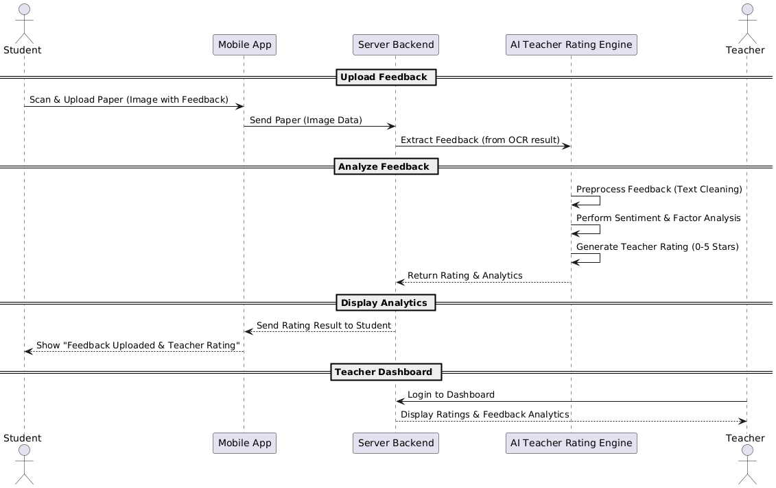
Process Flow Cont.
Notes:
We expect that when the student image is uploaded, a form like a survey form will be created on the mobile device to provide feedback about the teacher.

Slide 35

Algorithm Overview
Algorithm 1:
  Multi-Factor Teacher Rating Engine.
Algorithm 2:
  Real-time Mobile Analytics Processor.

Slide 36
Algorithm 1 - How Teacher Rating Engine Works
STEP 1
Sentiment Analysis Engine
01
STEP 2
Performance Trend Analyzer
02
STEP 3
Engagement Metrics Calculator
03
STEP 4
Composite Rating Algorithm
04

Slide 37

Step 1:
Student Feedback Analysis. (Sentiment Analysis)
Student Writes Feedback:
  "Teacher Feedback: Good At Teaching Math But Sometimes Too Fast"
AI Algorithm Process:
  Load BERT Model (Trained For Education)
  Process The Text
  Detect Emotions:
      Positive: "Good" → 0.7 Score
      Negative: "Too Fast" → 0.3 Score
  Overall Sentiment: 0.5 (Average)

Slide 38
Step 2:
Student Performance Analysis
Students' Marks In Teacher's Class:
  January: [65, 70, 55, 80, 75] → Average: 69
  February: [70, 75, 60, 85, 80] → Average: 74
  March: [75, 80, 65, 90, 85] → Average: 79
AI Algorithm Process:
  Time-series analysis (analyze marks over time)
  Calculate improvement: 69 → 74 → 79 (increasing)
  Compare with other teachers
  Performance score: 0.8 (good improvement)

Slide 39

Step 3:
Student Engagement Analysis
Class Data:
  Total Students: 30
  Students Asking Questions: 25 → 83% Participation
  Students Submitting Assignments: 28 → 93% Completion
  Active Involvement: High
AI Algorithm Process:
  Participation Rate : 25/30 = 0.83
  Completion Rate : 28/30 = 0.93
  Analyze Engagement Patterns
  Final Engagement Score : 0.88

Slide 40
Step 4:
Final Rating Calculation
Available Scores:
    - Sentiment Score: 0.5 (feedback analysis)
    - Performance Score: 0.8 (student improvement)
    - Engagement Score: 0.88 (class participation)
Weighted Formula :
Final Rating = (0.4 × Sentiment)+(0.35 × Performance)+(0.25 × Engagement)
Final = (0.4 × 0.5) + (0.35 × 0.8) + (0.25 × 0.88)
= 0.2 + 0.28 + 0.22
= 0.7
Convert to 5-star scale: 0.7 × 5 = 3.5 stars

Slide 41

Algorithm 2 - Mobile App Real-Time Processing
STEP 1
Edge Computing Optimization
1
STEP 2
Incremental Learning Algorithm
2
STEP 3
Smart Notification System
3
STEP 4
Adaptive UI Rendering
4

Slide 42

Step 1:
Phone Data Processing (Edge Computing)
Traditional systems:
  Phone → Send to Server → Server processes → Results back → Phone display
  Time: 5-10 seconds
My Algorithm:
  Phone processes locally → Results shown instantly
  Time: <2 seconds

Slide 43

Step 2:
Real-time Updates
When new feedback comes:
  1. Instantly analyze sentiment
  2. Update teacher rating
  3. Show on dashboard
  4. Send notification if important changes
Example:
  Old rating: 3.5 stars
  New feedback: "Teacher did very well today"
  New rating: 3.7 stars (0.2 increase)
  Notification: "Your rating improved!"

Slide 44

Step 3:
Offline Mode (Working Without Internet)
When there's no Internet:
  1. Store data in phone memory (24 hours)
  2. Run ML models on phone itself
  3. Display results on phone
  4. Sync to server when Internet returns
Example: “Village School Has No Internet”
  → App works offline
  → Process teacher ratings, student feedback
  → Upload to server when Internet available in evening

Slide 45

Research Gap & Novelty
Existing systems focus on grading students or generic feedback analysis
No integrated AI-driven teacher rating system with mobile support
Mobile + AI teacher rating engine developed from scratch

Slide 46
Research Gap : My Research vs “Automated Teacher Performance Evaluation Using ML Algorithms”
(IEEE Research Paper - 2021)
1.
Feature / Aspect | My Research | IEEE Research (2021)
Platform Support | Cross-platform (Mobile + Web) with native mobile features | ❌ Web-based system only
Document Processing | OCR integration with mobile camera capture for feedback forms | ❌ Manual data entry required
ML Algorithm Approach | Multi-factor ML models (performance trends, feedback analysis, engagement metrics) | ⚠️ Basic statistical modeling with limited parameters
Real-time Analytics | Continuous performance monitoring with instant insights | ❌ Periodic evaluation reports only
System Integration | Unified student grading + teacher rating platform | ❌ Teacher evaluation only (separate from student assessment)
Data Collection Method | Automated via mobile camera OCR + manual input options | ❌ Survey-based manual data collection
Deployment Model | Fully offline, self-trained ML models | ❌ Cloud-dependent system
Feedback Generation | Personalized improvement recommendations with actionable insights | ⚠️ Generic evaluation scores and basic reports

Slide 47
Research Gap : My Research vs “ML-Based Teaching Quality Assessment System”
(IEEE Research Paper - 2022)
2.
Feature / Aspect | My Research | IEEE Research (2022)
Mobile Application | Native mobile app with camera integration | ❌ No mobile application
OCR Technology | Custom OCR for handwritten/printed document processing | ❌ Digital input only
Assessment Scope | Combined student grading + teacher evaluation ecosystem | ❌ Teaching quality assessment only
ML Complexity | Multi-algorithm approach with NLP and deep learning | ⚠️ Classification algorithms only
Performance Monitoring | Real-time continuous monitoring and analytics | ❌ Scheduled batch processing
Independence | Fully self-contained with offline capabilities | ❌ External API dependencies

Slide 48
Technical Novelty Summary
Innovation Area | My Unique Contribution
Architecture | First Mobile-centric Teacher Rating System With Cross-platform Support
Data Collection | OCR - powered Document Capture Via Smartphone Cameras
ML Approach | Multi-parameter, Multi-algorithm Teacher Evaluation Engine
System Integration | Unified Student Grading + Teacher Rating Platform
Performance | Real-time Analytics With Continuous Monitoring
Deployment | Fully Offline, Self-trained ML Models

Slide 49
Automated Teacher Feedback Analysis Module
Hettiarachchi R.H - IT22120052

Slide 50
Overview of Contribution
Sub Objective:
Identify teacher improvement areas through performance and feedback analysis using AI
Key Tasks:
Analyze Student-Provided Feedback on Teachers
Evaluate Paper Design Using Bloom's Taxonomy
Detect Response Patterns
Generate Feedback for Teachers via NLP Models
Novelty:
AI-based automated teacher feedback system
by analyzing student-written feedback, paper structure, and response patterns

Slide 51
Problem Context
Teacher Evaluation is Manual and Inconsistent.
No Automated way to Analyze Teacher Feedback
Need an AI-based teacher feedback engine to give fair suggestions

Slide 52
Process Flow
Student completes answer sheet in physical classroom.
1
Student writes teacher feedback (at end of answer sheet).
2
Student scans and uploads paper via mobile app (OCR handled separately).
3
Feedback section is extracted using OCR.
4
System separates the teacher feedback section and routes it to the Teacher Feedback AI Engine.
5
AI Model processes feedback text using NLP to detect sentiment, common keywords, etc.
6
Paper structure is evaluated:
7
Bloom’s taxonomy tagging
Question clarity and distribution
Response patterns analyzed:
8
Skipped questions
Common confusion patterns
Combined insights used to generate comprehensive teacher improvement feedback.
9
Teacher accesses dashboard to view personalized suggestions.

Slide 53
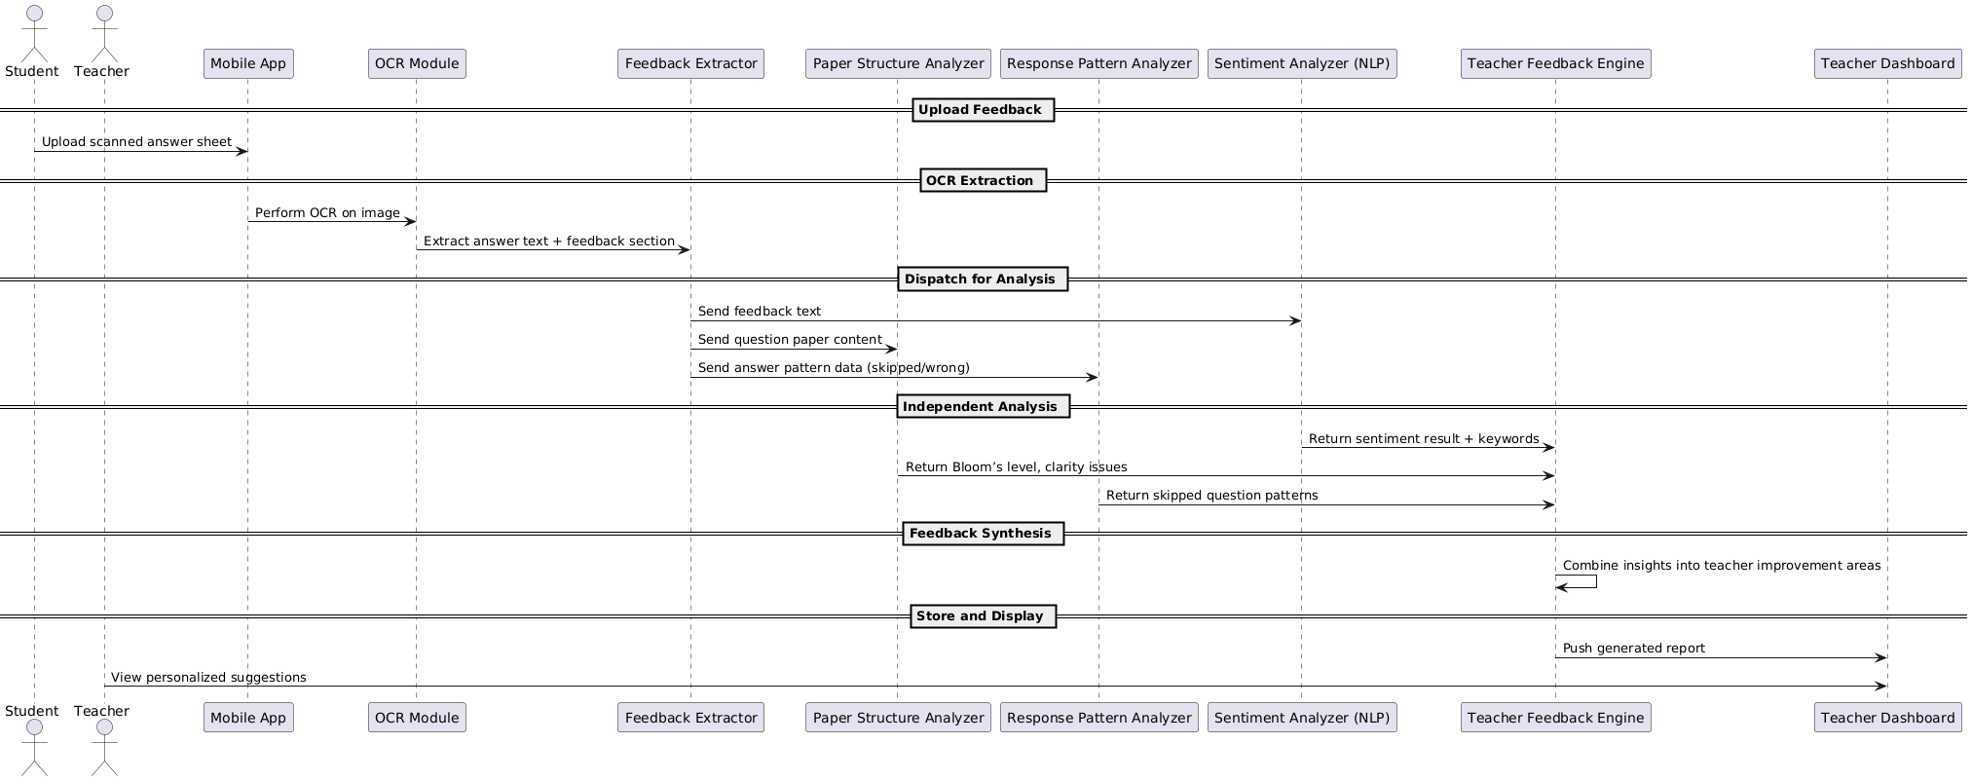
Process Flow Cont.

Slide 54

Algorithm Overview
Algorithm 1: Multi-Source Feedback Analysis Engine
Algorithm 2: Automated Bloom's Taxonomy Classification
Algorithm 3: AI-Powered Response Pattern Detection

Slide 55

Algorithm 1
Multi-Source Feedback Analysis Engine
Novel Contribution:
First system to combine handwritten student feedback sentiment analysis with performance data and paper structure evaluation.
Key Features:
OCR Integration: Extract handwritten feedback from answer sheets
NLP Processing: Clean and preprocess extracted text
Sentiment Analysis: AI-powered emotion & satisfaction detection
Keyword Extraction: Identify teaching issues and positive patterns

Slide 56
Algorithm Process
Input: Handwritten student feedback from exam papers
1
OCR Extraction: Convert handwriting to digital text
2
Text Preprocessing: Clean, normalize, and structure the text
3
Sentiment Analysis: Detect emotions, satisfaction levels, teaching issues
4
Theme Identification: Extract key teaching strengths and weaknesses
5
Insight Generation: Generate specific improvement recommendations
6

Slide 57
Example Insights Generated:
"73% of students mention 'too fast' - consider slowing down lesson pace"
"Students frequently praise 'clear examples' - strength in concept explanation"
"Multiple complaints about 'hard to understand' - review communication style"

Slide 58
Algorithm 2
Automated Bloom's Taxonomy Classification
World-First Innovation:
Automated Bloom's Taxonomy Classification is an AI system that instantly analyzes exam questions and categorizes them from simple recall (like "What is...?") to complex thinking (like "Design a solution..."), helping teachers create balanced tests by automatically identifying whether their questions are too easy or appropriately challenging across all cognitive levels.

Slide 59

Bloom's Taxonomy Levels Analyzed :
Remember (Knowledge) - Recall facts and basic concepts.
Understand (Comprehension) - Explain ideas or concepts.
Apply (Application) - Use information in new situations.
Analyze (Analysis) - Draw connections among ideas.
Evaluate (Evaluation) - Justify decisions or courses of action.
Create (Synthesis) - Produce new or original work.

Slide 60
AI Features Extracted:
Action Verbs Identification: "Define", "Analyze", "Create", "Evaluate"
Question Type Detection: Multiple choice, essay, short answer
Cognitive Load Indicators: Complexity markers in question structure
Context Complexity Analysis: Difficulty level assessment

Slide 61
Algorithm Process
Question Input: Extract questions from exam papers
1
Linguistic Analysis: Identify action verbs and question patterns
2
Deep Learning Classification: Use trained model to classify Bloom's level
3
Distribution Analysis: Calculate percentage for each taxonomy level
4
Recommendation Generation: Suggest improvements for balanced assessment
5

Slide 62
Example Classification Output:
Current Distribution: Remember (70%), Understand (20%), Apply (8%), Analyze (2%)
AI Recommendation: "Increase higher-order thinking questions. Add more analysis and evaluation questions."
Specific Suggestion: "Change 'What is photosynthesis?' to 'How do environmental factors affect photosynthesis rates?'"

Slide 63
Algorithm 3
AI-Powered Response Pattern Detection
Breakthrough Innovation:
First system to use student response patterns for identifying specific teaching gaps and content delivery issues.
Skipped Questions: Questions left blank by high percentage of students
Pattern Types Detected:
Common Errors: Repeated mistakes indicating teaching gaps
Time Patterns: Questions attempted vs. time allocation
Difficulty Indicators: Questions with low success rates

Slide 64
Algorithm Process
Data Collection: Gather student response data from multiple exams
1
Pattern Analysis: Use machine learning to identify trends
2
Gap Detection: Link patterns to specific teaching issues
3
Severity Assessment: Classify issues as high, medium, or low priority
4
Recommendation Generation: Provide specific teaching improvements
5

Slide 65
Example Pattern Detection:
Pattern Found: 70% of students skipped Question 5 on "Complex Literary Analysis"
AI Analysis: Teaching gap detected in advanced analysis techniques
Generated Recommendation: "Revisit how you taught literary analysis methods. Students may not understand the systematic approach. Consider using step-by-step examples."

Slide 66

Smart Detection Capabilities:
Automatic Threshold Setting: AI determines concerning skip rates
Cross-Topic Analysis: Identify patterns across different subject areas
Temporal Tracking: Monitor improvement over time
Predictive Insights: Forecast potential teaching challenges

Slide 67
Examples For System-Generated Teacher Feedbacks
Analysis Area | Data Source | Detected Issue / Insight | Generated Feedback for Teacher
Feedback Sentiment Analysis | Analyzing written feedback from students for tone, clarity, frustration | Multiple mentions of “too fast” and “hard to understand.” | "Slow down during lessons and use more examples. Many students feel rushed."
Response Pattern Recognition | Detect if many students skip/misunderstand the same question | 70% of students skipped Question 5. | "Revisit how you taught Topic 3; students may not have understood the concept well."
Paper Structure Effectiveness | Analyzed question paper using Bloom’s Taxonomy | 90% of questions are recall-based. | "Try incorporating more application and evaluation-level questions in future papers."
Syllabus Coverage Mapping | Map paper questions against syllabus to detect topic gaps | No questions from Unit 4 were found in the final exam. | "Include questions from all syllabus sections to ensure balanced assessment."

Slide 68
Research Gap Covered
Most existing research focuses only on analyzing feedback forms or online reviews to evaluate teaching quality, they do not incorporate actual student performance data or evaluate assessment design.
Our system introduces a novel approach by combining performance trend analysis, NLP-based sentiment extraction from handwritten exam feedback, Bloom’s Taxonomy classification of exam questions, and skipped/wrong response detection to provide a deeper, data-driven understanding of teaching effectiveness.
This fills a crucial gap in current AI-driven academic evaluation systems by directly linking student behavior and performance to teacher improvement strategies.

Slide 69
Research Gap : My Research vs Automated Teacher Performance Evaluation Using ML Algorithms (IEEE Research Paper - 2021)
My Research | Existing Research
My system evaluates teachers using student performance trends and feedback analysis, mostly automated via AI | Emphasizes Teacher Self-Evaluation (TSE), IQA-led evaluations, and human factors like personality, engagement, classroom climate
Uses NLP, Bloom's Taxonomy, and student feedback to rate teachers based on student performance and paper quality | Points out that existing evaluations ignore student outcomes, lack real-time, structured insights, and mostly focus on compliance
Our goal is automated, non-biased, improvement-focused feedback | IEEE highlights problems in existing systems: fixed schedules, rigid criteria, compliance-based reviews

Slide 70

Student Improvement areas & Performance analysis
Jayasooriya L.T – IT22095480

Slide 71
Overview of Contribution
Sub Objective
Identify student improvement areas through performance analysis
Key Tasks
Use ML to analyze scores and errors to Detect weak learning areas; Generate personalized improvement recommendations
Novelty
Real-time AI feedback system for personalized academic support without external datasets

Slide 72
Problem Context
Lack of Centralized Student Access to Exam Results
Limited Insight into Question-wise Evaluation and Improvement Areas
Absence of Secure and Personalized Student Access

Slide 73
Process Flow
Student Scans Answer Paper & Upload Via Mobile App
Server Stores Uploaded Paper
(OCR Done By Other Module)
Student engine model analysis the data
Identify student improvement areas and student evaluation method
Mobile App & WEB Displays Analytics To Student

Slide 74
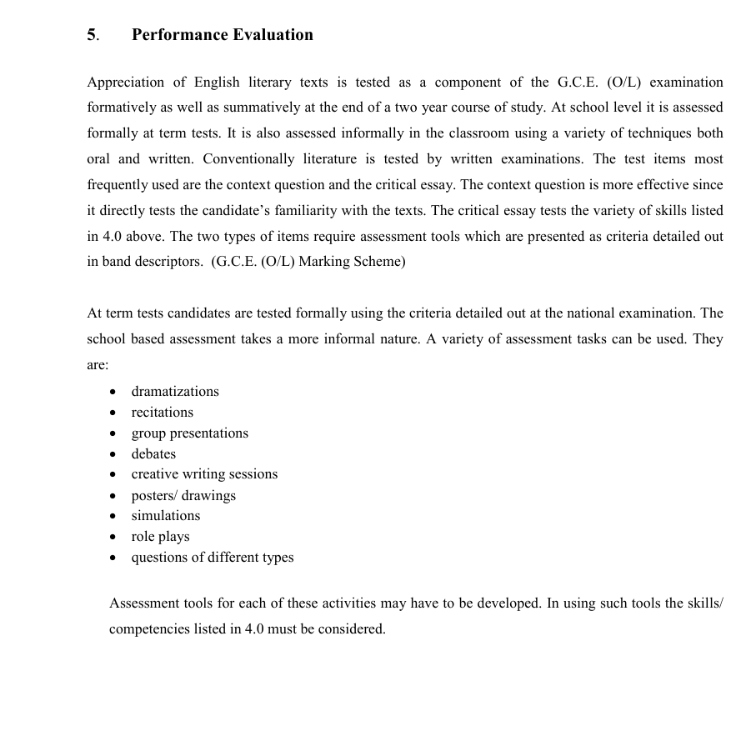
Performance Evaluation
The Appreciation of English Literary Texts syllabus clearly outlines the evaluation process for Grade 11 students at the G.C.E. Ordinary Level. The following image illustrates the assessment criteria used in evaluating students' performance.

Slide 75
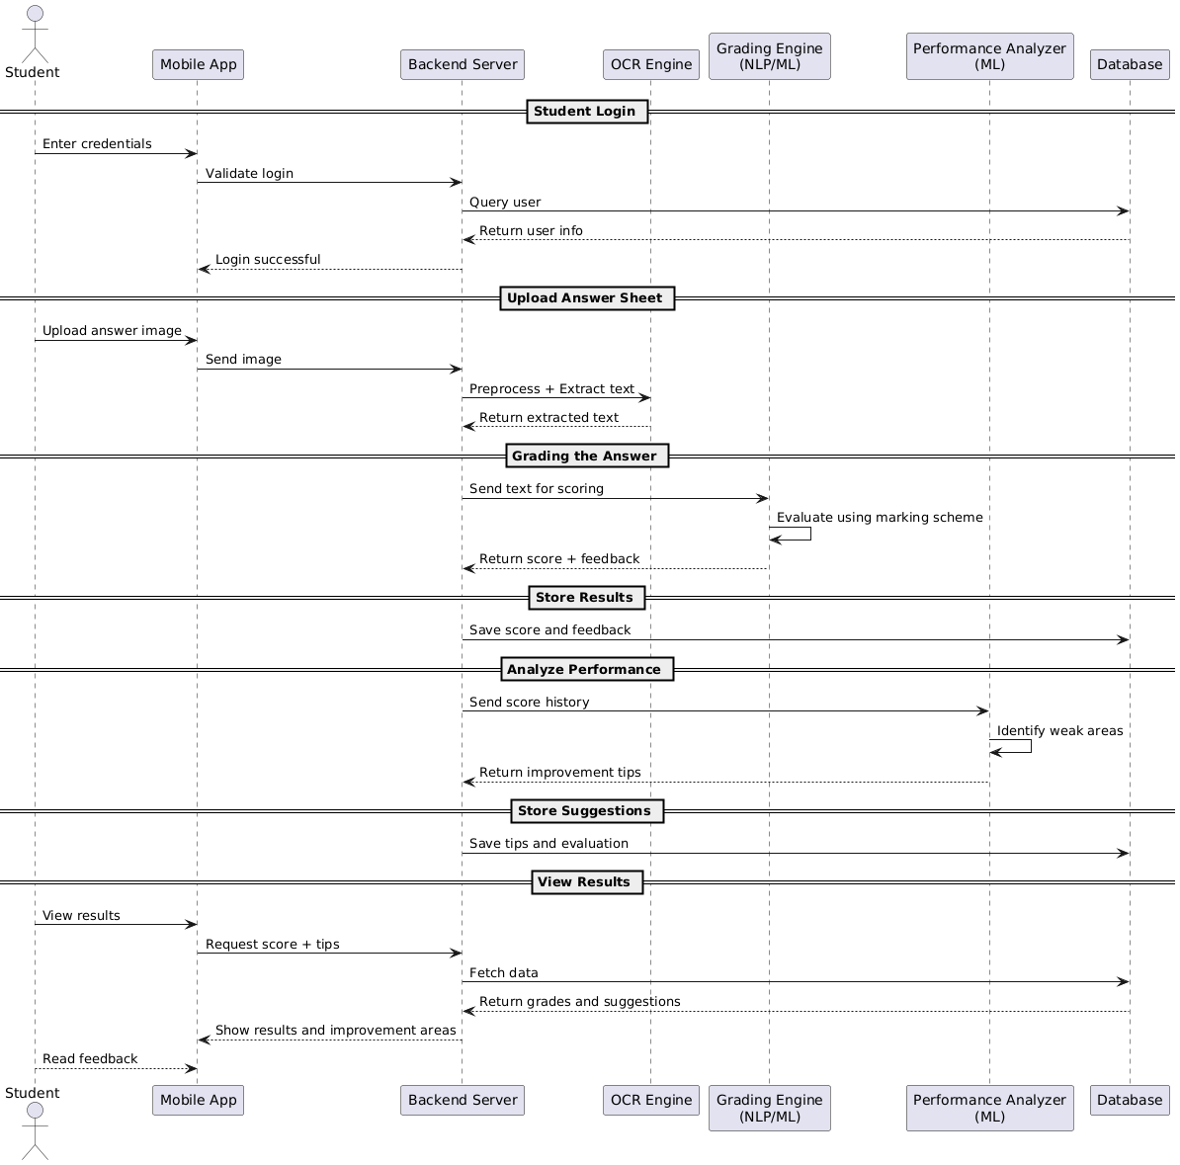
Process Flow Cont.

Slide 76
Gap Analysis: My Research vs. “A Needs Analysis in Second Language Teaching (English Language): A Study on Grade 10,11 Students in the Sri Jayawardenapura Educational Zone”
Feature / Aspect | Your AI Research | Existing Research
Analysis Method | AI-driven pattern recognition using ML | Manual questionnaires and interviews
Data Collection | Continuous automated assessment data | One-time survey (60 students)
Skill Gap Detection | Real-time automated identification | Manual teacher observation and student self-report
Personalization | Individual performance-based recommendations | Generic suggestions for all students
Coverage Scope | All English skills (speaking, listening, reading, writing, grammar) | Limited to speaking and listening focus
Progress Tracking | Continuous ML-based monitoring | Periodic manual evaluation
Feedback Delivery | Instant AI-generated suggestions | Delayed teacher-dependent feedback

Slide 77
What is my contribution
Algorithm 1: Granular Skill Gap Detection
Problem: Students know their overall grade but not specific skills to improve.

Slide 78

Solution Algorithm:
INPUT: Student essay + Grade 11 English Literature skill framework
STEP 1: Skill Decomposition
Break response into skill components:
Theme analysis (25%)
Character development (20%)
Literary devices (15%)
Textual evidence (20%)
Writing structure (20%)
STEP 2: Component-wise Evaluation
NLP models trained on each skill separately
Compare student performance to grade expectations
Calculate gap severity (critical/high/medium/low)
STEP 3: Interdependency Analysis
Identify skills that build on others
Prioritize foundational skills first
Map learning prerequisite chains
STEP 4: Improvement Potential Assessment
Estimate effort required for improvement
Consider student's learning history
Predict realistic improvement timeline
OUTPUT: Ranked list of skill gaps with improvement difficulty

Slide 79

Key Points
Innovation: First granular skill analysis for literature students
Visual: Spider diagram showing student skill levels vs expectations
Impact: Students improve 3x faster with targeted skill focus

Slide 80

Algorithm 2: Personalized Learning Path Generator
Problem: Generic study advice doesn't match individual student learning patterns.

Slide 81
Solution Algorithm:
INPUT: Student skill gaps + Learning style + Performance history
STEP 1: Learning Style Detection
Analyze response patterns (visual vs analytical)
Identify preferred question types
Detect optimal challenge level
STEP 2: Goal Setting Algorithm
Set SMART goals for each skill gap
Sequence goals by dependency and difficulty
Estimate realistic timelines
STEP 3: Resource Matching
Match learning resources to style preferences
Select appropriate difficulty level
Include variety to maintain engagement
STEP 4: Adaptive Scheduling
Space practice sessions optimally
Adjust based on progress rate
Include review sessions for retention
STEP 5: Progress Prediction
Model expected improvement curves
Set intermediate milestones
Predict final outcome with confidence intervals
OUTPUT: 4-week personalized study plan with daily tasks

Slide 82
Key Points
Innovation: First AI-generated personalized literature study plans
Visual: Gantt chart showing personalized learning timeline
Impact: Students following AI plans score 25% higher on average

Slide 83
Algorithm 3: Predictive Performance Modeling
Problem: Students and teachers don't know early warning signs of academic struggles.

Slide 84
Solution Algorithm:
INPUT: Historical performance + Current behavior patterns
STEP 1: Feature Engineering
- Extract performance trends (improving/declining)
- Behavioral indicators (submission timing, engagement)
- Social factors (peer comparison, teacher interaction)
STEP 2: Time Series Forecasting
- Use LSTM networks for sequence prediction
- Account for seasonal patterns (exam periods)
- Include external factors (difficulty changes)
STEP 3: Risk Classification
- Predict probability of grade drop
- Identify at-risk students early
- Classify intervention urgency levels
STEP 4: Intervention Recommendation
- Match predicted problems to proven solutions
- Suggest timing for interventions
- Estimate intervention success probability
OUTPUT: Early warning alerts + specific intervention suggestions

Slide 85
Key Points
Innovation: Predicts student performance problems 6 weeks early
Visual: Dashboard showing risk indicators and recommended actions
Impact: Early intervention prevents 80% of predicted failures

Slide 86
Thank You !

